Slide 1





energy
Introduction
A global urban typology for transferable evidence-based climate solutions
Geographic Distribution of the Research
Cities play a crucial role in addressing climate change close to where people live.
76% of cities are covered by no more than one study – a large gap to guide action.
Nobel laureate Elinor Ostrom emphasized decentralized experimentation and learning from local successes, but a systematic analysis remains lacking.
Research on decarbonization covers mostly China and the US.
Simon Montfort, Florian Nachtigall, Claudia Binder, Marta Olazabal, Tim Repke, Felix Creutzig
Distributional barriers have become more prominent from Assessment Reports 2 to 6 (AR2 – AR6) by the Intergovernmental Panel on Climate Change
Distributional barriers are important in developed countries.
Research Question
What is the evidence-based learning potential from climate solutions implemented in other similar cities?
Methods
There is too little decarbonization research on the industry sector.
1) Develop a global typology of cities
>11k cities in the Global Human Settlement Layer
Deep Embedded Clustering to group cities based on shared characteristics
2) Construct a scientific evidence database
Using keywords, download 230k articles on climate change and cities
Use topic modelling to classify topics
Identify >50k case studies using using keyword-match-augmented geoparsing
Conclusion
3) Analyze the learning potential
Map the characteristics of 4 types of cities to identify common challenges
Based on research topics documenting climate solutions, map these across the different types of cities to understand the learning potential
We show what enablers may be activated depending on the specific barriers that hamper climate policy adoption.
Relatively little research documents institutional capacity barriers but many of the enablers address this barrier.
More research is needed that shows which enablers may relax distributional barriers.
Most comprehensive scientific evidence database in this domain
Links evidence types and city types
Provides a basis for a systematic selection and in-depth review of city case studies in the IPCC Special Report on Cities.
Scan me to download the full paper
Based on the in-depth mixed-method review (see Methods, step 3). For definitions of the concepts, scan the QR code for access to the full paper.

Slide 2







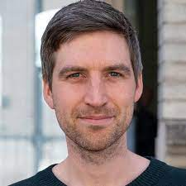


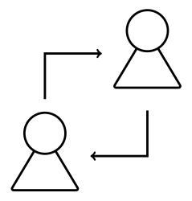






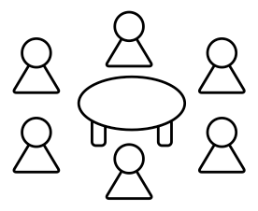




Simon Montfort
Selected Supplementary Materials: Definition of Barriers and Enablers
Poster Hand-Out
SNF Doc.CH fellow PhD Candidate
Oeschger Centre for Climate Change Research
Mercator Institute on the Global Commons and Climate Change
Poster in small format.
Selected supplementary information.
Barrier | Definition
Distributional Dynamics | Include struggles between actor coalitions, interest group lobbying, veto player action, and ideological clashes based on identity or deep-held beliefs and convictions.
Economic Cost | High cost of low-carbon technological and behavioural change for private and public actors.
Institutional Capacity | Lack of governmental institutions’ competencies, resources, and expertise.
Multi-level Governance | Free-riding at the international level and lack of enforcement between vertical governance levels (communal, national, regional, and international).
Accessing information:
Scan me
Open for the poster in small size.
Flip for selected supplementary materials to the poster.
Check out information on the authors.
Dr. Lukas Fesenfeld
Postdoctoral Researcher
Oeschger Centre for Climate Change Research
Lecturer at ETH Zürich
Focus on Climate and Food Policy
Enabler | Definition
Regulatory Agency Coordination | Government-internal coordination through existing or new institutional venues, as well as leadership in governance processes with actors that are external to the government.
Science-Policy Interface | Links between the scientific (systematic evaluation and interpretation of evidence) and the political domain (decision and policy-making for the introduction of laws, regulations and other governing principles).
Communicat- ion and Framing | Communication can create an awareness of climate change, political challenges and potential mitigation options. Framing can aim at increasing support for climate policy by changing the perception of problems and its causes.
Participation and Deliberation | Participatory and deliberative processes include civil society involvement, government consultation about stakeholder positions, commissions and deliberative assemblies where either stakeholders or citizens make proposals to the government.
Policy Design | Policy Design includes the specific policy instruments (e.g. tax or subsidy) and their calibrations (e.g. the height of the tax).
Bottom-up | Bottom-up processes are decentralized arrangements that allow for experimentation with new governance arrangements, including city-to-city organizations or carbon clubs.
Scan me
Prof. Dr. Karin Ingold
Vice President of the Oeschger Centre for Climate Change Research
Chair of ProClim
Group leader of Policy Analysis and Environmental Governance
Correspondence & Info:
Email: simon.montfort@unibe.ch
Project website: s-montfort.ch
SNF grant: 207269
Scan me

